Slide 1




Data Science HACKATHON
SKIN DISEASE CLASSIFICATION
[TEAM 12]

Slide 2
DERMDOC
Problem Statement
20% to 30% of all cases seen in general practice in developing countries are dermatological…

Slide 3
Problem Statement ... This could arguably be higher due to the tendency of patients to self-diagnose skin diseases
DERMDOC

Slide 4
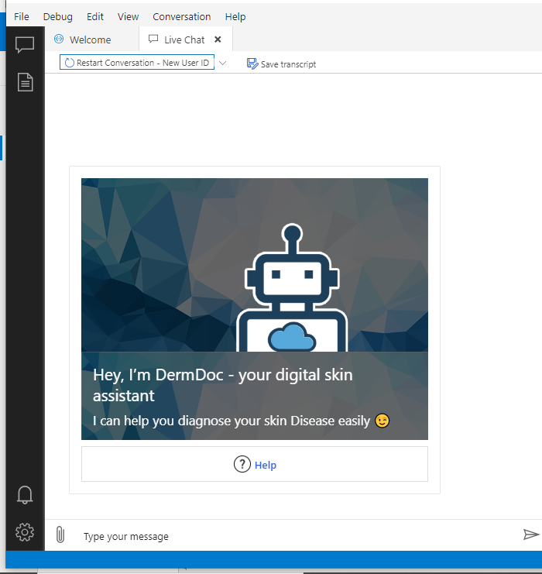
DERMDOC
Our proposition
Introducing DermDoc...

Slide 5
A data product that helps users diagnose skin diseases from the treatment of their homes. Users are also connected to a nearby dermatologist for treatment and/or give home remedies
DERMDOC
...Introducing DermDoc

Slide 6
DERMDOC
Our Data:
DermNet
Global Skin Atlas
Dataset
Our data consists of images of skin diseases verified by dermatologists and sourced from two different websites

Slide 7
DERMDOC
Our Data:
Acne
Eczema
Lichen Planus
Dermatitis
Warts
We used image data on 5 of the top 10 most popular skin diseases reported in Ghana

Slide 8
DERMDOC
Deep Dive on Solution
A Demonstration on Microsoft Azure Computer Vision and Microsoft Bot Framework

Slide 9
DERMDOC
The Solution Process
2.
Upload
(User)
3.
Process
(Model)
1.
Connect
(User)
5. Recommend
(Bot)
4.
Predict
(Model)

Slide 10
[DERMDOC]
Ending Notes: Way Forward
Expand on model to include more diseases
Book an appointment with a nearby dermatologists
Deploy solution through a mobile app

Slide 11



DERMDOC
Meet the Team(Team 12)
Richard Kadey
Priscilla Baah
Cyril Avevor

